Slide 1

Project Title -
Airbnb Hotel Booking Analysis
Name
Prabhat Pandey
AICTC ID
STU68382c9509d451748511893

Slide 2

PROBLEM STATEMENT
The hospitality industry has undergone a significant transformation with the rise of online platforms facilitating short-term lodging and tourism Leading this revolution is Airbnb, Inc., a pioneering American company that has reshaped travel accommodation through its innovative online marketplace. Established in 2008 in San Francisco, California, Airbnb provides a diverse range of lodging options, offering guests a unique and personalized experience. Unlike traditional hospitality providers, Airbnb operates on a commission based model, facilitating transactions between hosts and guests without owning the properties listed on its platform.
This research analysis delves into the New York City Airbnb dataset to extract meaningful insights. Through rigorous data cleaning, exploratory analysis, and visualization techniques, the study aims to illuminate the dynamics of the city's lodging market. By discerning factors influencing listing availability, pricing strategies, and overall customer satisfaction, the research contributes to a deeper understanding of Airbnb's operations in one of the world's most dynamic urban environments. These insights hold significance for stakeholders and enthusiasts seeking to navigate the evolving landscape of short-term accommodation.

Slide 3
Project Description
This project focuses on building a machine learning model to predict the price of Airbnb listings. Pricing an Airbnb property correctly is crucial for both hosts and travelers: hosts want to maximize occupancy and earnings, while travelers want fair and competitive prices. Using historical Airbnb data, the project develops a regression model that learns relationships between listing attributes (such as number of bedrooms, bathrooms, and guest ratings) and the price charged.
The model can then be used to predict prices for new or hypothetical listings, helping property owners make informed pricing decisions.

Slide 4

WHO ARE THE END USERS?
Airbnb Hosts
To optimize pricing of their listings based on property features and guest reviews.
Travelers
To evaluate whether a listing is overpriced or reasonably priced.
Airbnb Platform Analysts
To improve automated pricing suggestions and increase platform trust.
Researchers/Students
To study the impact of property features and reviews on rental pricing.

Slide 5

Technology Used
Python - Core programming language.
Pandas & NumPy - Data cleaning and preprocessing.
Scikit-learn - Machine learning (model training, regression, evaluation).
Matplotlib/Seaborn- Data visualization and feature importance.
Google Colab - Cloud-based environment for running the projectFile handling libraries - openpyxl (for Excel) and built-in CSV handling.

Slide 6
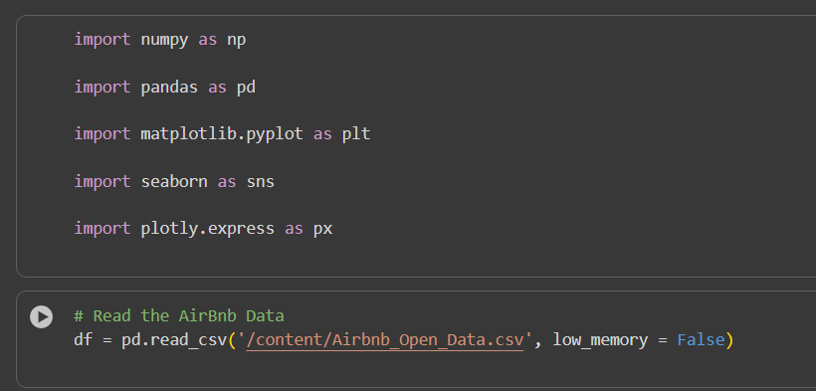
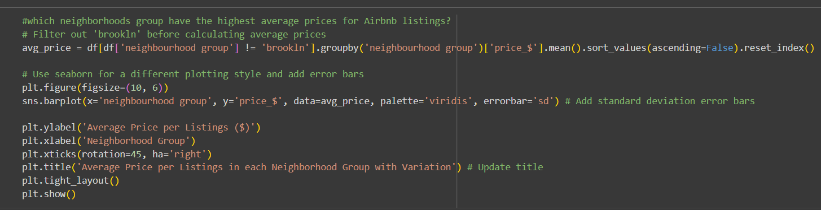
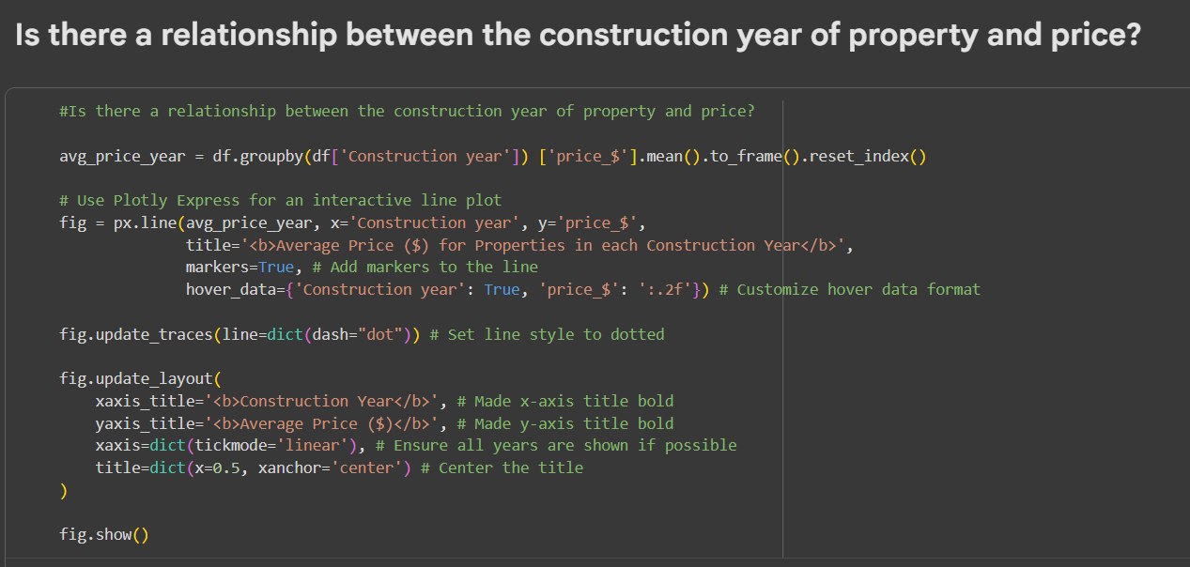
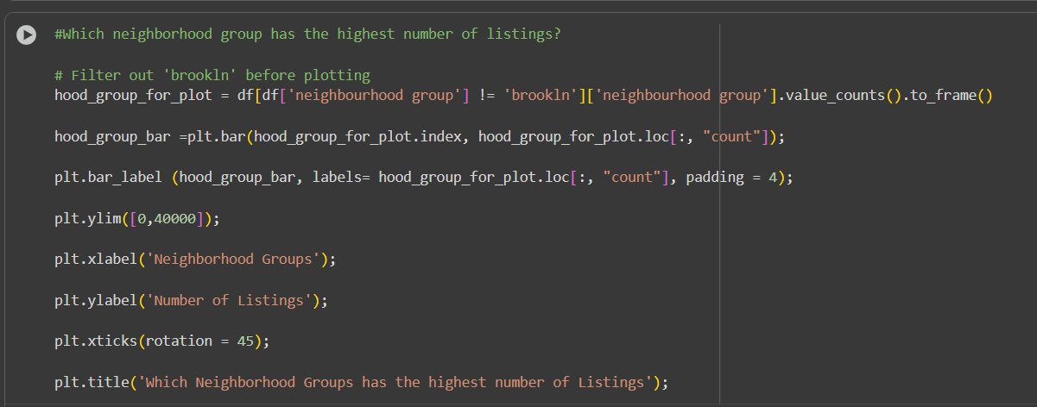
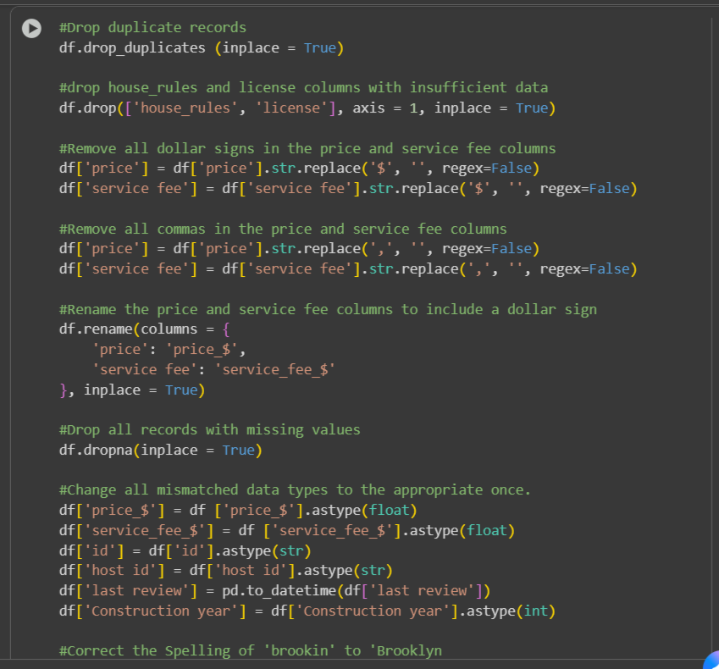
Python code

Slide 7
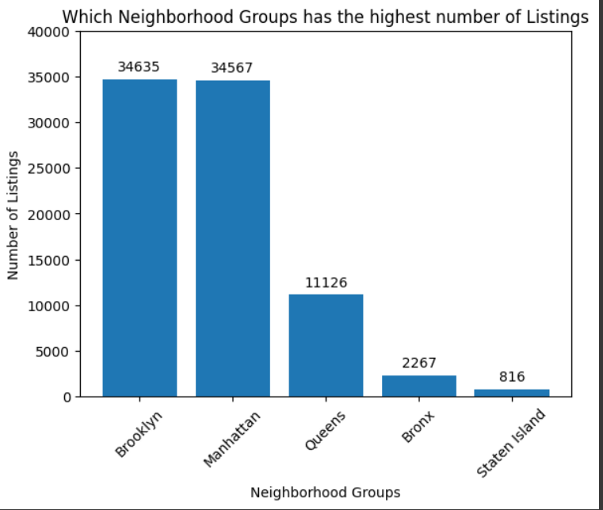
RESULTS1

Slide 8
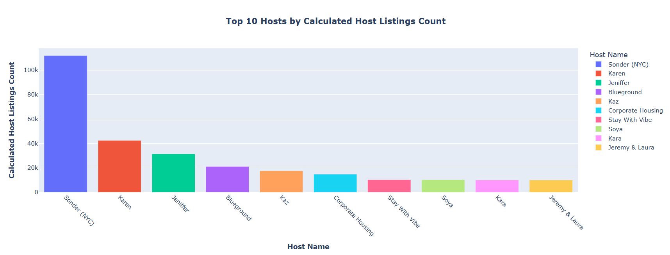
RESULTS2

Slide 9
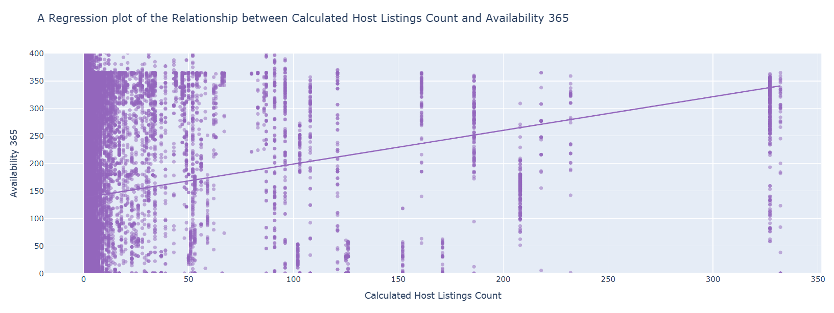
RESULTS3

Slide 10
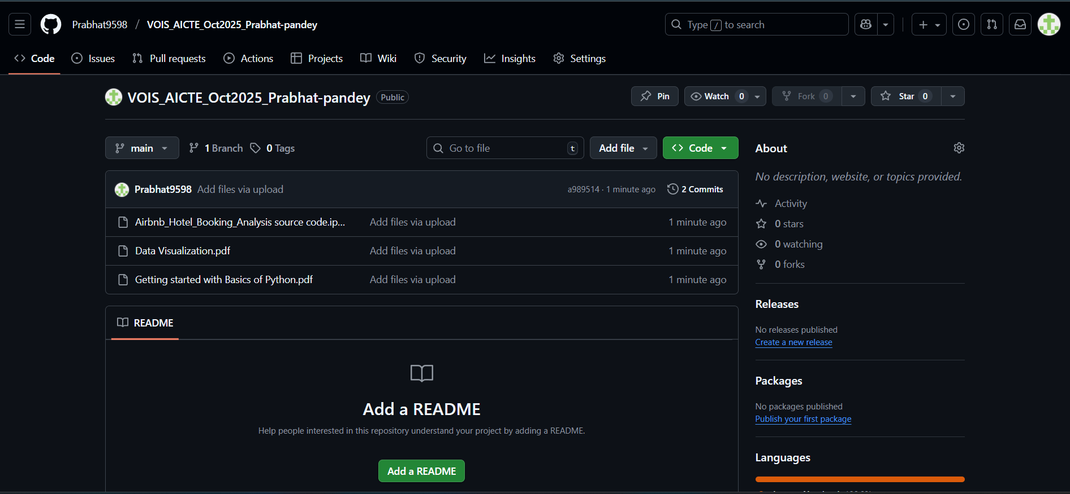
GitHub repository
https://github.com/Prabhat9598/VOIS_AICTE_Oct2025_Prabhat-pandey.git

Slide 11
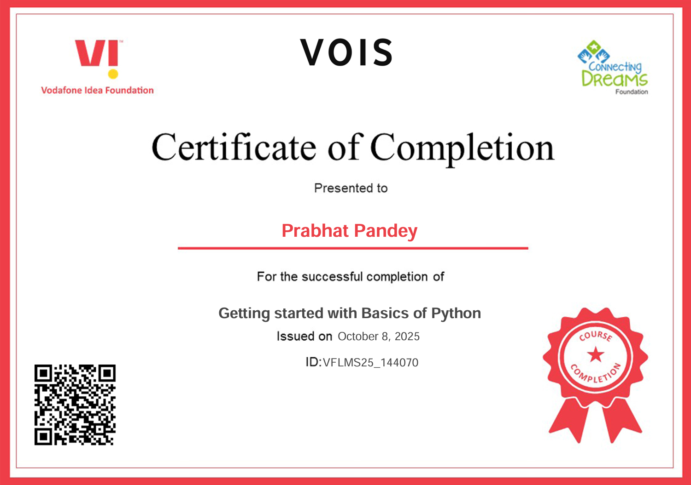
Getting started with Basics of Python Certificate

Slide 12
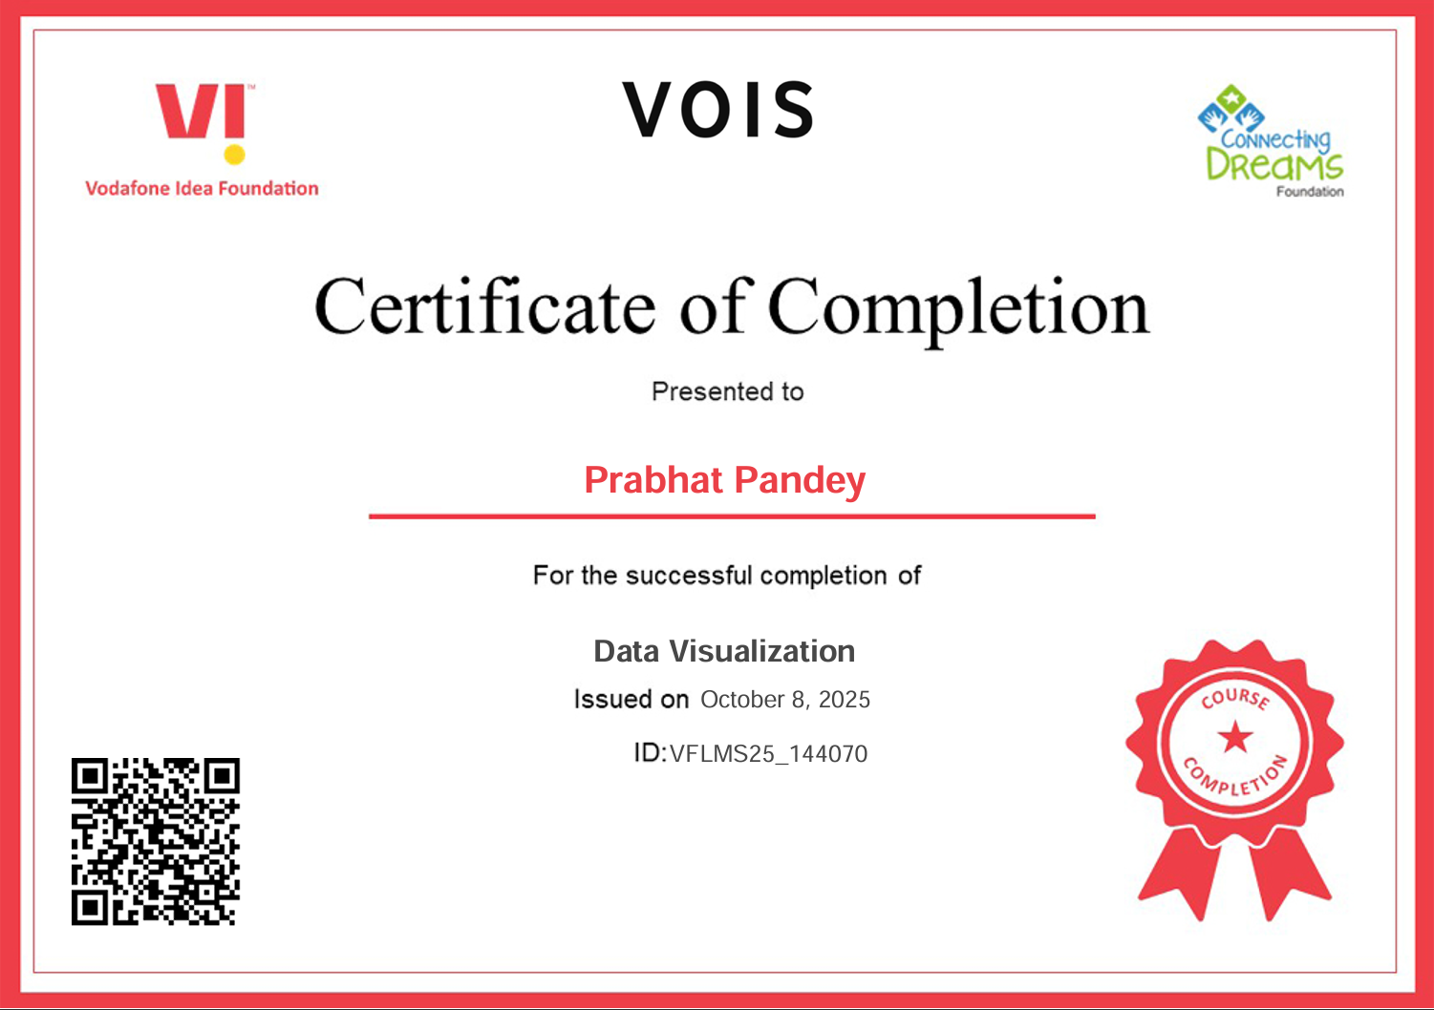
Data Visualization Certificate
[Paste your Certificate Here]

Slide 13

Thank you
.
.

